Slide 1
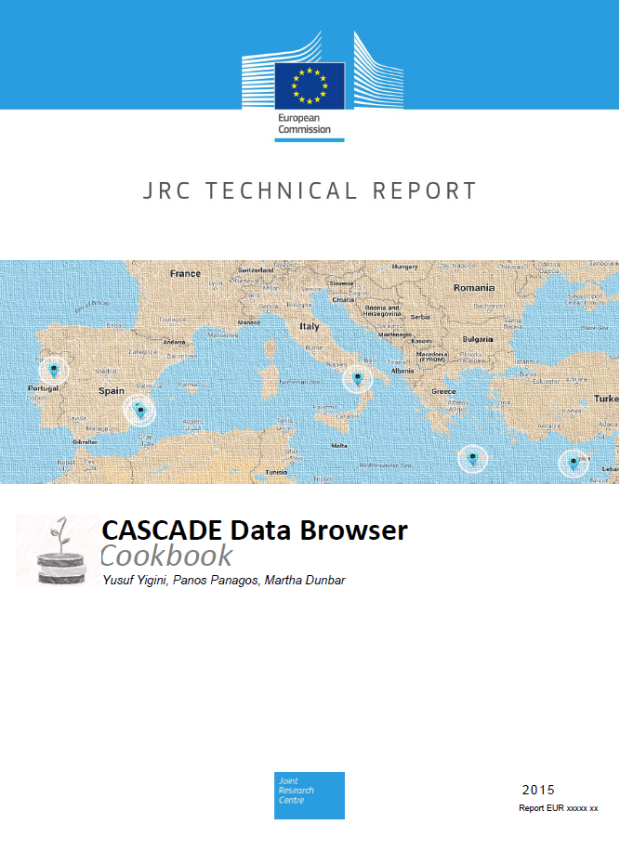
CASCADE Data Services
Yusuf Yigini, Panos Panagos, Martha B. Dunbar
Joint Research Centre - European Commission

Slide 2
Why Data Sharing is crucial for Scientific Projects?
Data sharing and exchange between partners is an important task throughout a projects entire life cycle.
Even if it sounds simple, we should not underestimate the importance of data sharing. Like a lifeblood, data sharing helps us to work in a better environment.

Slide 3
Why Data Sharing is crucial for Scientific Projects?
1. Decision Making : This is probably the most important and easy thing. All the partners need to have an access to the data in order to take decisions.
2. Process Streamline: The work packages need to work in a most efficient way. Which means – we need to focus on process and communication. If we have a tool to share/exchange data, we probably going to spend less time in communication.
3. Global development support: The time, when all people in the projects were located in the same building is over. Now, people can be located everywhere globally. To have an easy access to the data from multiple places is another crucial requirement these days.

Slide 4
Data Sharing Solutions
Traditional Data Storage/Sharing: MS Access, e-mail exchange
Cloud storage services : Google Drive, Dropbox, SkyDrive etc.

Slide 5
MS ACCESS
Microsoft Access is not meant to have multiple users at any given time. While it can support them, problems with functionality can pop up.
All the information from a database is saved into one file - this can limit what we can do with it and slow down reports, queries, and forms.
Real time collaboration is not possible

Slide 6
Dropbox
Does not provide advanced sharing tools
Cannot view occurring activity on the shared files
No audit log capabilities for free version
Not proficient with collaboration. Dropbox doesn’t do well is simultaneous editing.
“Limited Versioning” for free user accounts
Privacy concerns
It’s not free (2gb)?

Slide 7
Google Drive
Google Drive has many advantages:
realtime collaboration, storage capacity, cross platform compatibility
But also disadvantages:
Limited sharing capabilities, formatting issues, supports limited file formats, difficulties on database design and scientific data exchange

Slide 8
Tailored Design?
Scientific projects need more “tailored” data sharing approach.
Role-based data access/editing permissions
Versioning – to have the ability to track changes and easy to 'roll back' to an earlier version of the information
full control over data
To keep project data available even after the project is archived

Slide 9
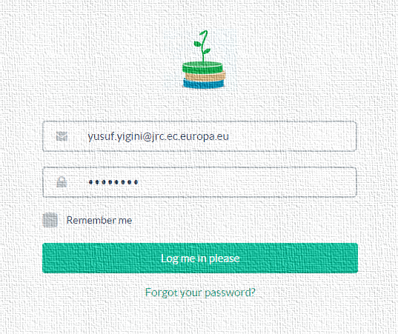
CASCADE Data Browser (V2.1-Beta)
In the light of the above-mentioned concerns, we have intended to develop a system with regard to our existing needs and requirements

Slide 10
Full Data Control
Batch Data Import & Manual Data Entry
Data Export (.csv, .pdf)
Versioning
Role Based Permissions
The system is live at : http://cascadeu.info/ username: info@cascadeu.info and the password: cascaded

Slide 11
Server Preparation
Confirm Server Specifications
Confirm User and Login, Accessing Server
Key Software Installation
Database Management Script Installation
Integration and Configuration of Web Services
Data and Services
CASCADE Data Integration
Data Access
The system is live at : http://cascadeu.info/ username: info@cascadeu.info and the password: cascaded

Slide 12
Server Preparation
PHP 5+
Apache Webserver
MySQL with support
Root access to the MySQL server
An FTP Client
Databased (licensed)
The system is live at : http://cascadeu.info/ username: info@cascadeu.info and the password: cascaded

Slide 13
Key Software Installation
Databased is a self-hosted database application, allowing access to MySQL databases for non-IT people and technical people alike. And this framework allows partners working with databases in a very user friendly environment.
The system is live at : http://cascadeu.info/ username: info@cascadeu.info and the password: cascaded

Slide 14
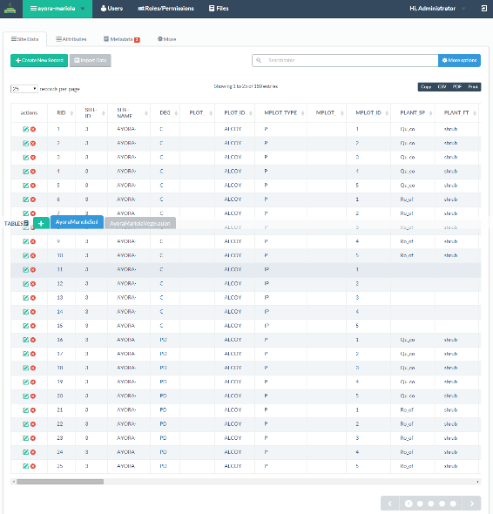



Databases and Data Services
The system is live at : http://cascadeu.info/ username: info@cascadeu.info and the password: cascaded

Slide 15
ACCESSING & WORKING with DATA
The system is live at : http://cascadeu.info/ username: info@cascadeu.info and the password: cascaded

Slide 16
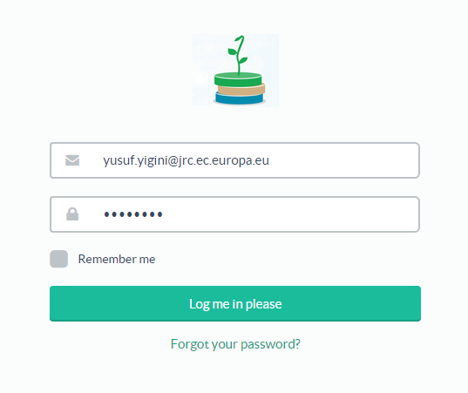
The system is live at : http://cascadeu.info/ username: info@cascadeu.info and the password: cascaded
The Cascade Data Browser is running on a Linux Environment with Databased framework.
The system is a self-hosted database application, allowing access to MySQL databases and users.
The system is live at : http://cascadeu.info/ username: info@cascadeu.info and the password: cascaded

Slide 17
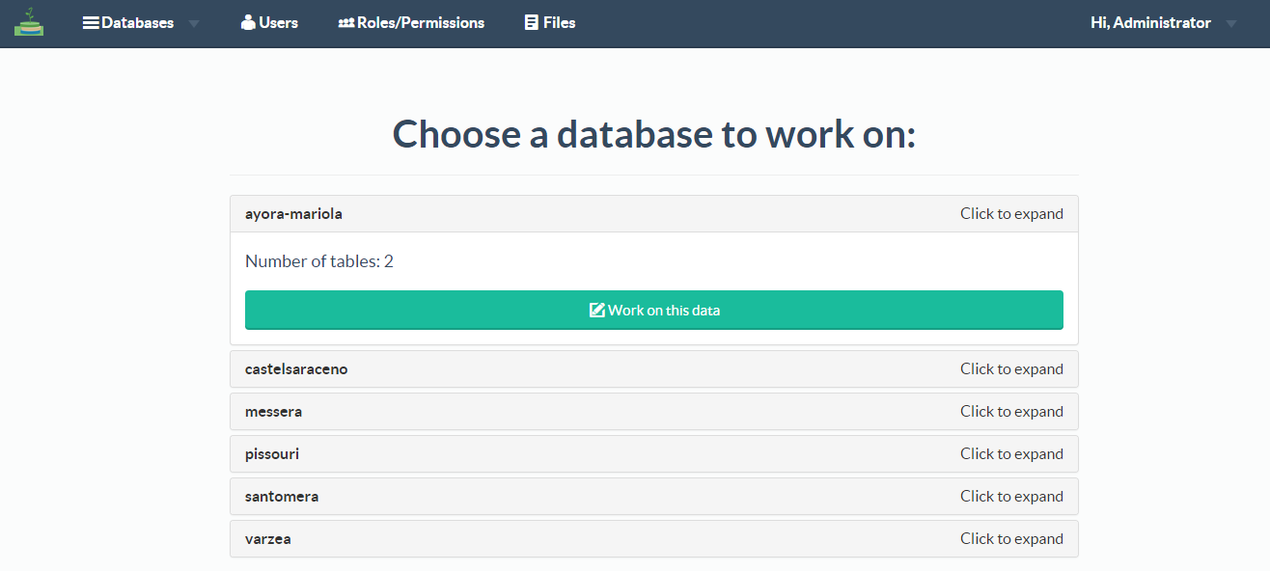
Database selection screen allows users to select database to work on.
(based on their permissions)
The system is live at : http://cascadeu.info/ username: info@cascadeu.info and the password: cascaded

Slide 18
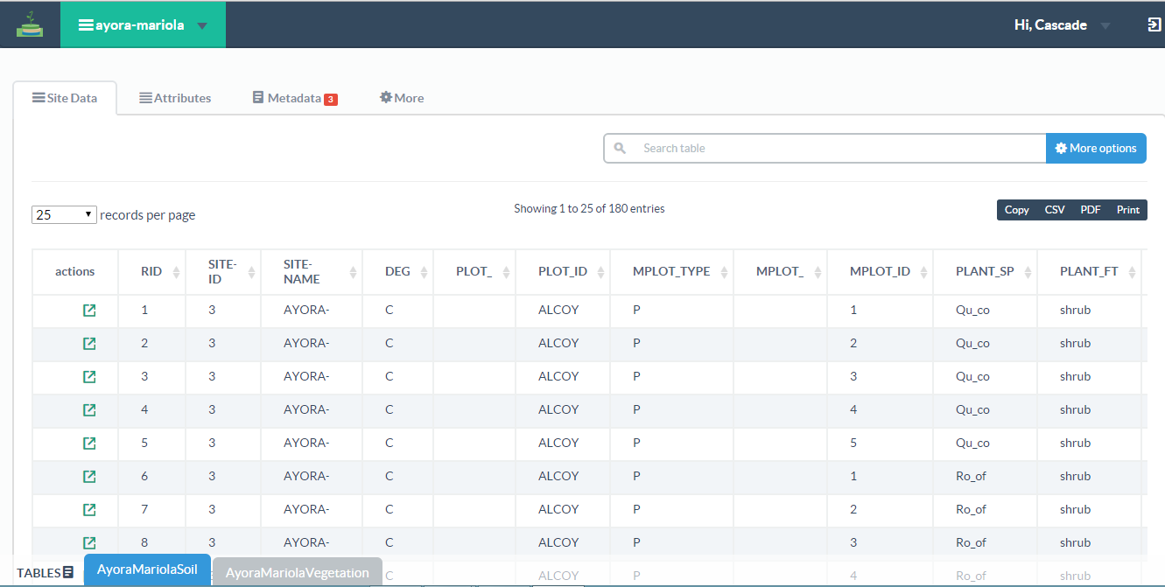
Database Tables
Soil Database

Slide 19
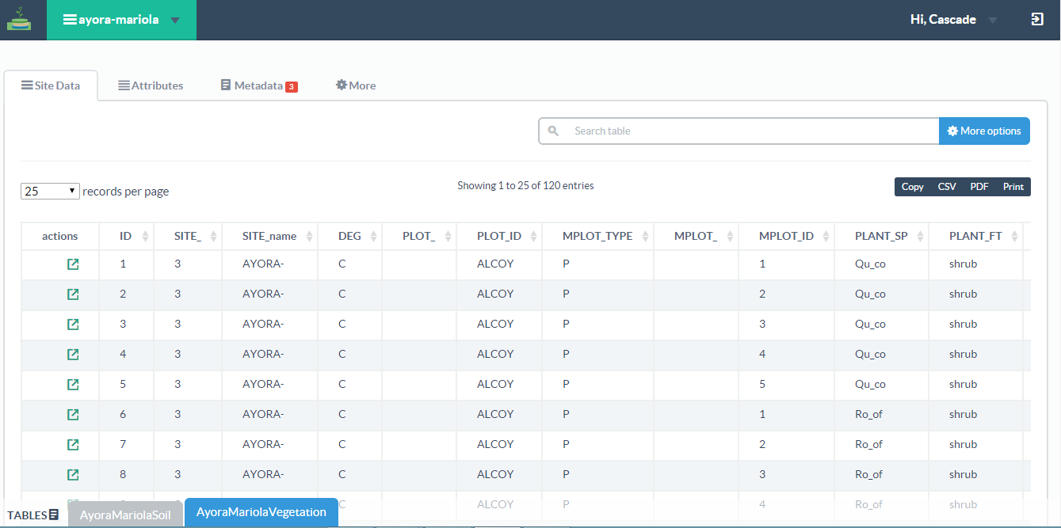
Database Tables
Vegetation Database
The system is live at : http://cascadeu.info/ username: info@cascadeu.info and the password: cascaded

Slide 20
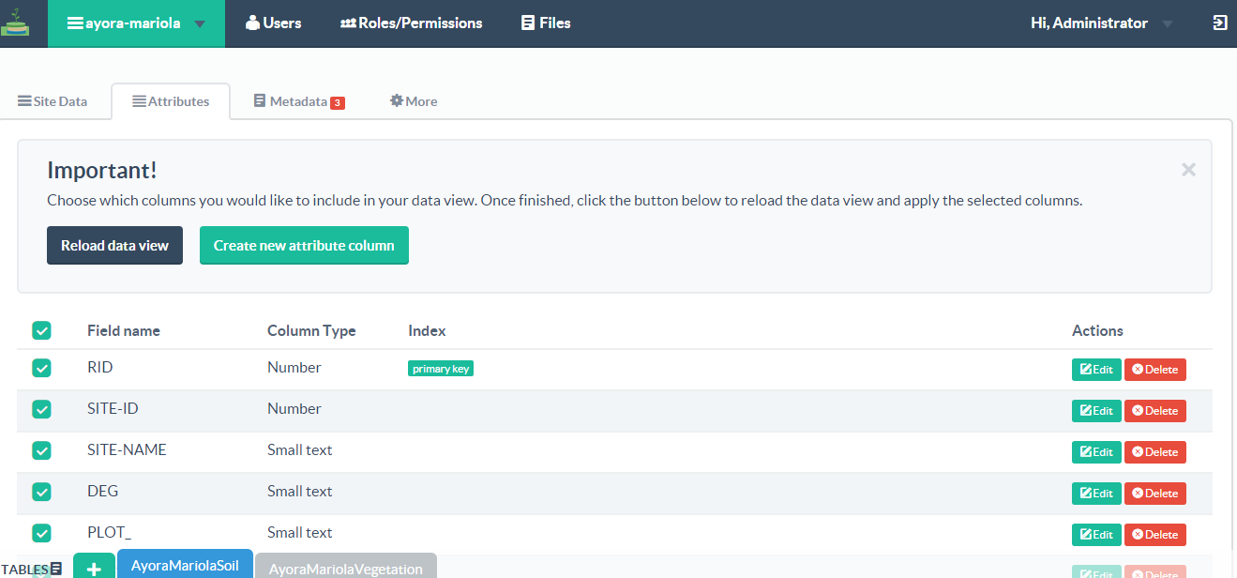
Database Columns
Attribute screen allows users to manage database columns (attributes)
The system is live at : http://cascadeu.info/ username: info@cascadeu.info and the password: cascaded

Slide 21
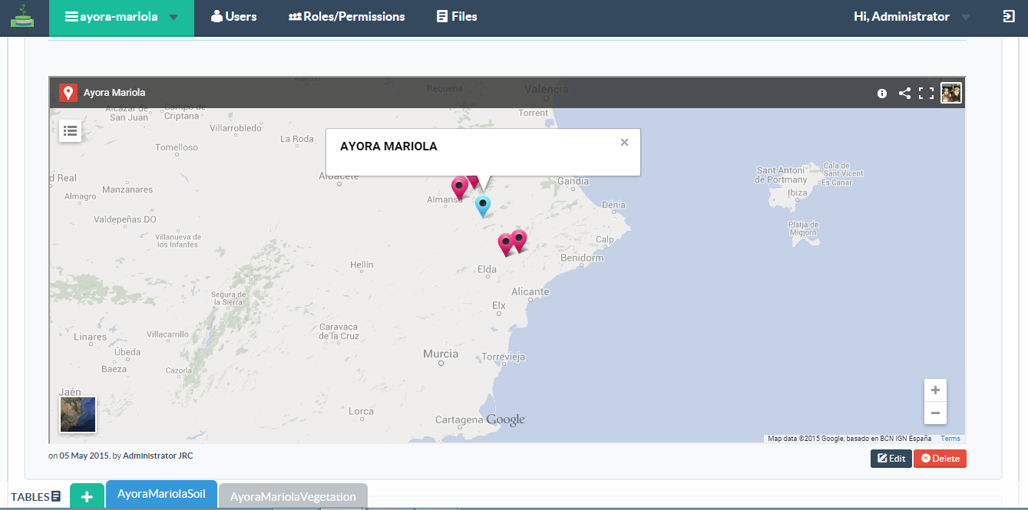
Metadata Tabs – Site and Sampling Locations
The system is live at : http://cascadeu.info/ username: info@cascadeu.info and the password: cascaded

Slide 22
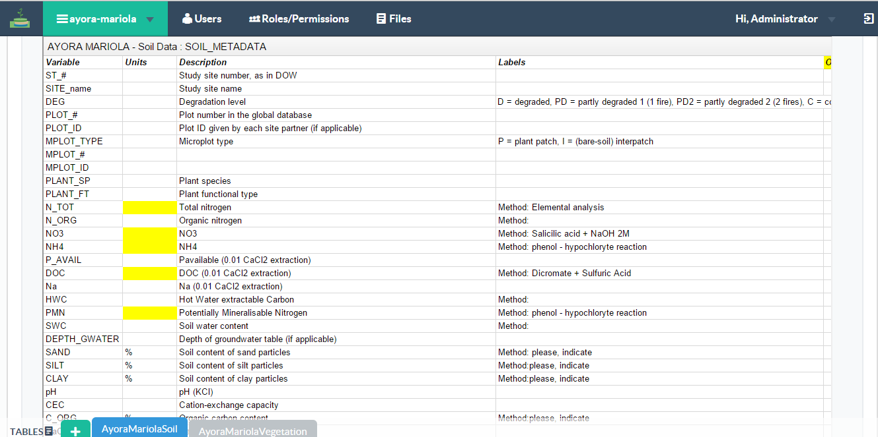
Metadata Tabs – Plant and Soil Metada
The system is live at : http://cascadeu.info/ username: info@cascadeu.info and the password: cascaded

Slide 23
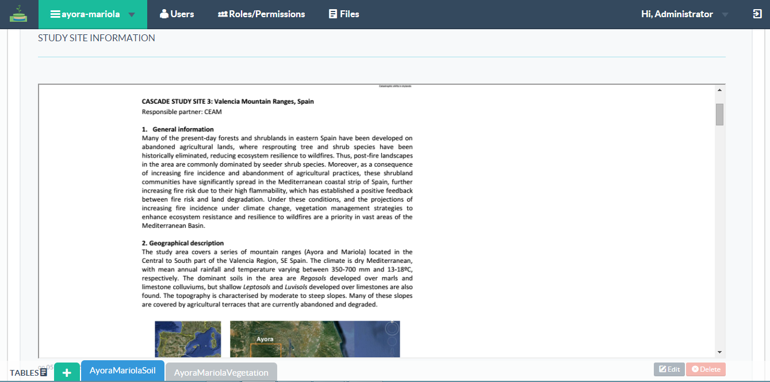
Metadata Tabs – Site Information
The system is live at : http://cascadeu.info/ username: info@cascadeu.info and the password: cascaded

Slide 24
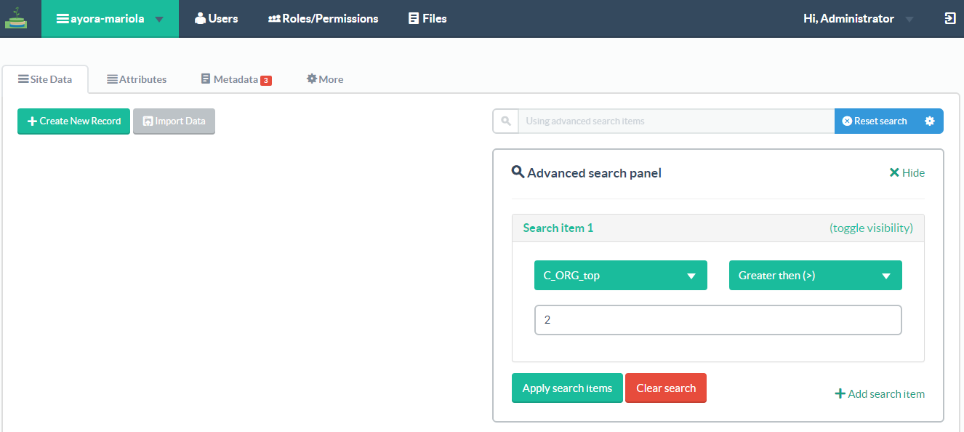
Search Filters
The system is live at : http://cascadeu.info/ username: info@cascadeu.info and the password: cascaded

Slide 25
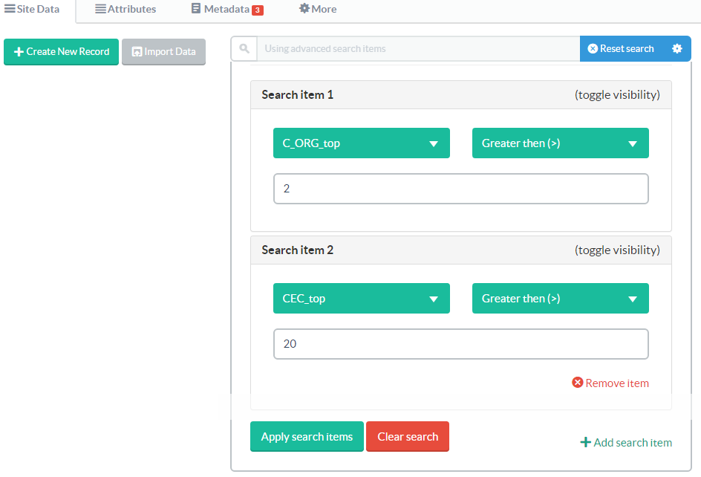
Search Filters
2+
The system is live at : http://cascadeu.info/ username: info@cascadeu.info and the password: cascaded

Slide 26
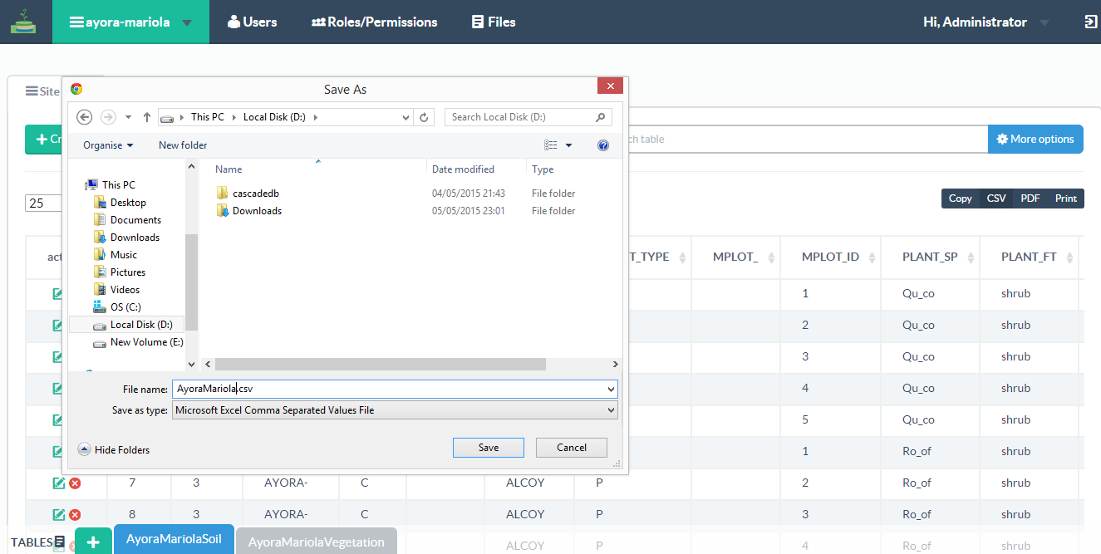



The system is live at : http://cascadeu.info/ username: info@cascadeu.info and the password: cascaded

Slide 27
USERS - ROLES and PERMISSIONS
The system is live at : http://cascadeu.info/ username: info@cascadeu.info and the password: cascaded

Slide 28
USERS - ROLES and PERMISSIONS
The CASCADE Data Browser is built with user roles. This means that we can define a certain roles (Project Leader, WP Leader, Project Member, Public) and setup permissions for these Roles.
Then, a Role can be assigned to a user account which will determine what the user can or can not do.
The system is live at : http://cascadeu.info/ username: info@cascadeu.info and the password: cascaded

Slide 29
The system supports unlimited number of users and roles.
The system is live at : http://cascadeu.info/ username: info@cascadeu.info and the password: cascaded

Slide 30
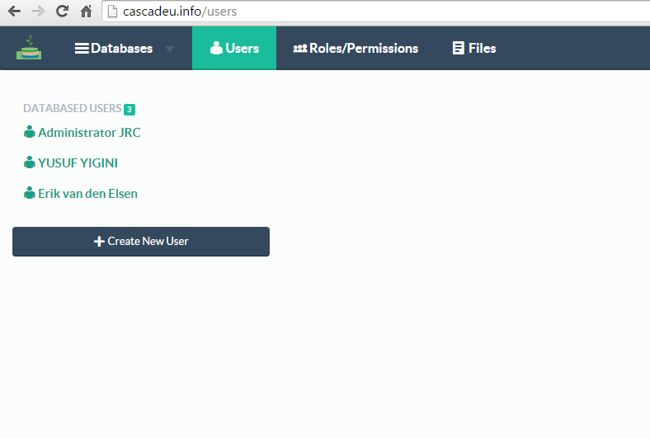
The system is live at : http://cascadeu.info/ username: info@cascadeu.info and the password: cascaded

Slide 31
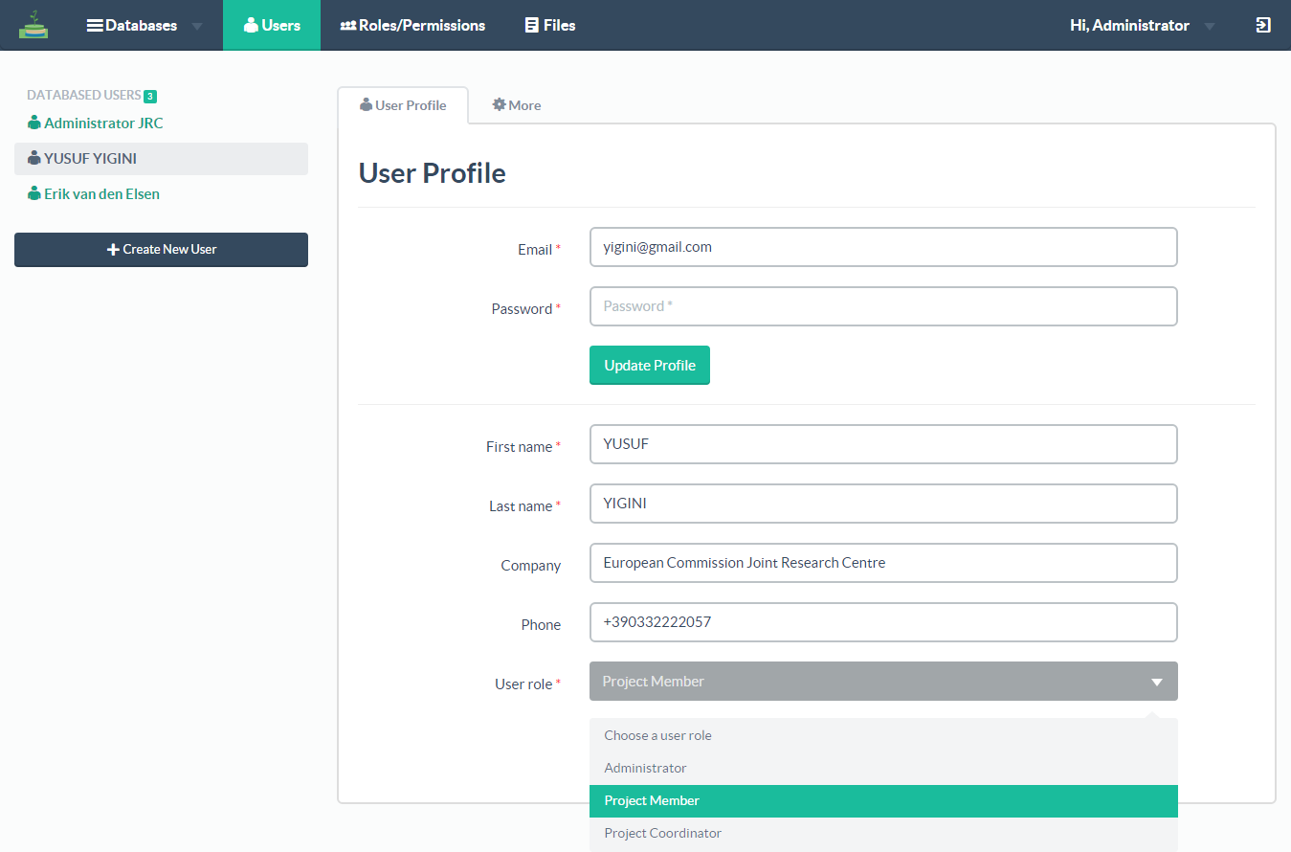
The system is live at : http://cascadeu.info/ username: info@cascadeu.info and the password: cascaded

Slide 32
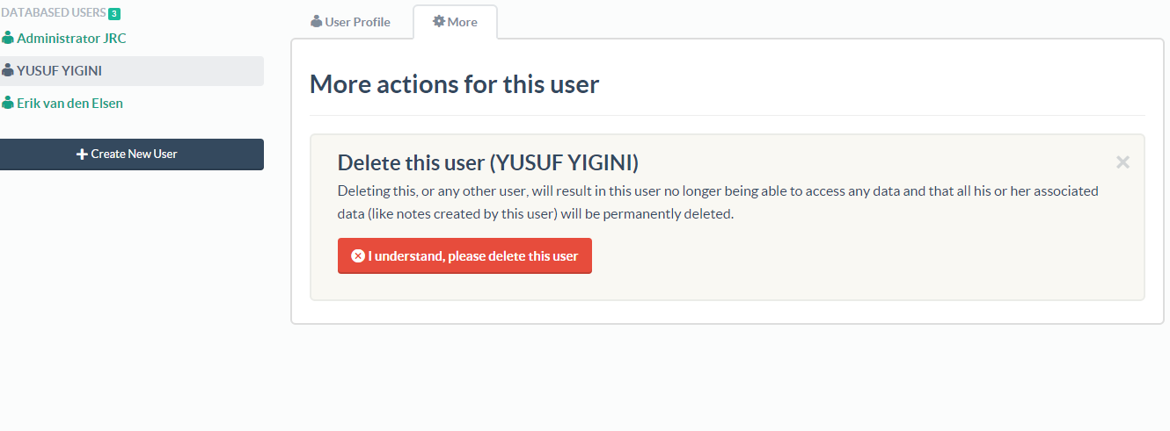
The system is live at : http://cascadeu.info/ username: info@cascadeu.info and the password: cascaded

Slide 33
Role Based Permissions
The system allows us to use role-based permissions. The permissions can be defined individually. – for every user/role. – with regards to certain operations,
Create a new database
Create a new Table in an existing Database
Edit, Delete, Import, Export
Add/Edit Users, Roles

Slide 34
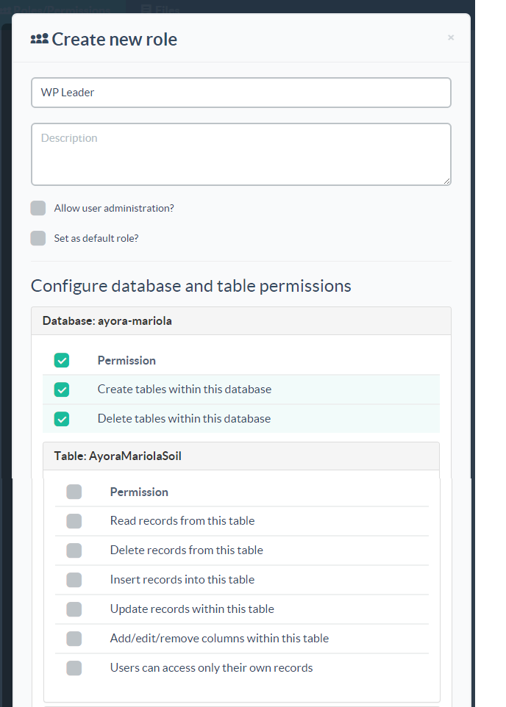
Role Details
Database Permissions
Table Permissions
The system is live at : http://cascadeu.info/ username: info@cascadeu.info and the password: cascaded

Slide 35
EDITING – CREATING DATA
The system is live at : http://cascadeu.info/ username: info@cascadeu.info and the password: cascaded

Slide 36
Data Editing
The system is live at : http://cascadeu.info/ username: info@cascadeu.info and the password: cascaded

Slide 37
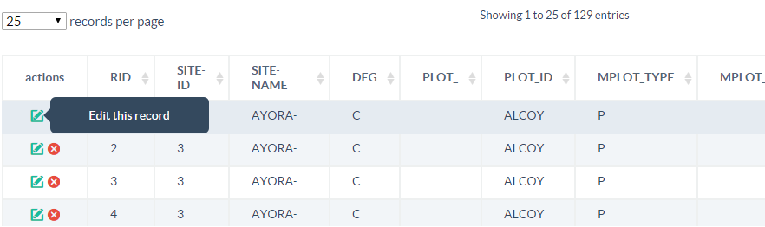
Data Editing
The system is live at : http://cascadeu.info/ username: info@cascadeu.info and the password: cascaded

Slide 38
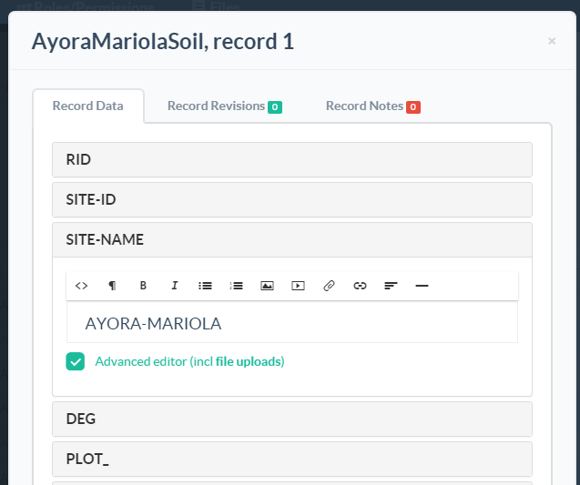
Editing/
Updating a Single Record
The system is live at : http://cascadeu.info/ username: info@cascadeu.info and the password: cascaded

Slide 39
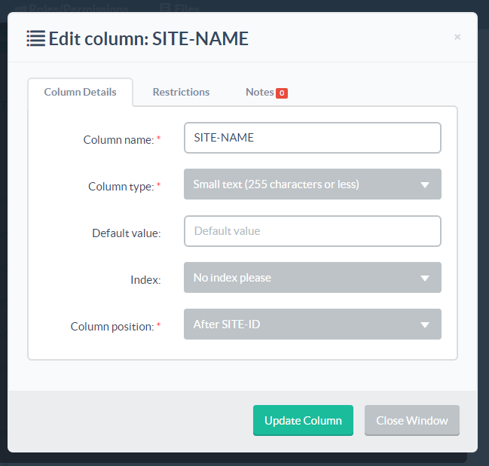
Attribute screen
The system supports the following column types:
Numbers (up to 11 digits)
Small text (up to 255 characters)
Big text
Date
and
file uploads; allows to upload files and link these from within records.
The system is live at : http://cascadeu.info/ username: info@cascadeu.info and the password: cascaded

Slide 40
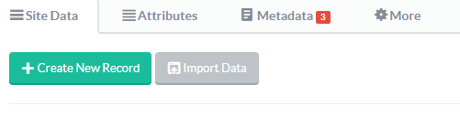
The system is live at : http://cascadeu.info/ username: info@cascadeu.info and the password: cascaded

Slide 41
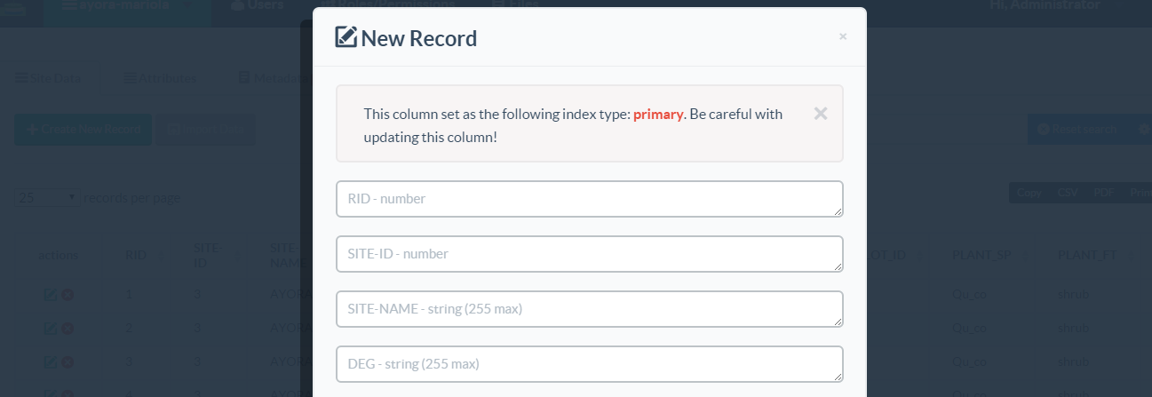
Creating a Single Record
The system is live at : http://cascadeu.info/ username: info@cascadeu.info and the password: cascaded

Slide 42
The system is live at : http://cascadeu.info/ username: info@cascadeu.info and the password: cascaded

Slide 43
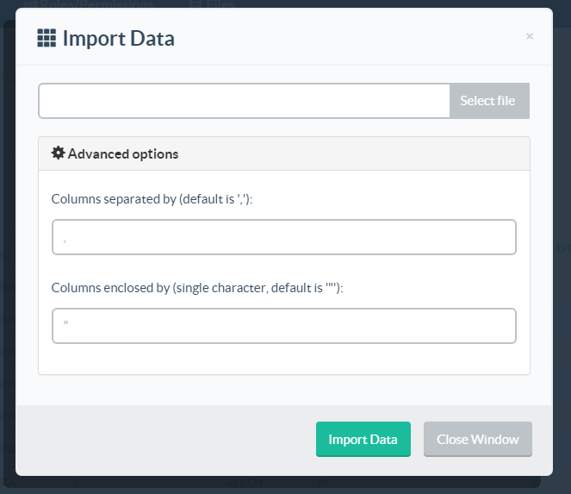
The system is live at : http://cascadeu.info/ username: info@cascadeu.info and the password: cascaded

Slide 44
Batch Data Import
The system supports batch imports.
CSV file can be Imported using the import tool.
The system is live at : http://cascadeu.info/ username: info@cascadeu.info and the password: cascaded

Slide 45
Improvements
Fine tuning (bugs, problems, new features)
Missing Data
Adding all project users into the system
…
The system is live at : http://cascadeu.info/ username: info@cascadeu.info and the password: cascaded

Slide 46
In preparation
The system is live at : http://cascadeu.info/ username: info@cascadeu.info and the password: cascaded

Slide 47
Thank You ☺

